Slide 1

Computer Graphics: Shading
CS 498VR: Virtual Reality
UNIVERSITY OF ILLINOIS AT URBANA-CHAMPAIGN
Eric Shaffer

Slide 2
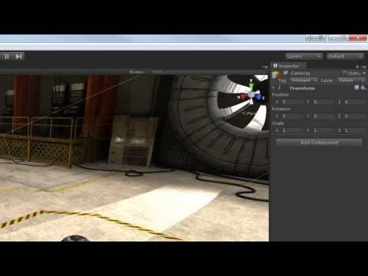
Quaternions in Unity
https://www.youtube.com/watch?v=TdjoQB43EsQ

Slide 3
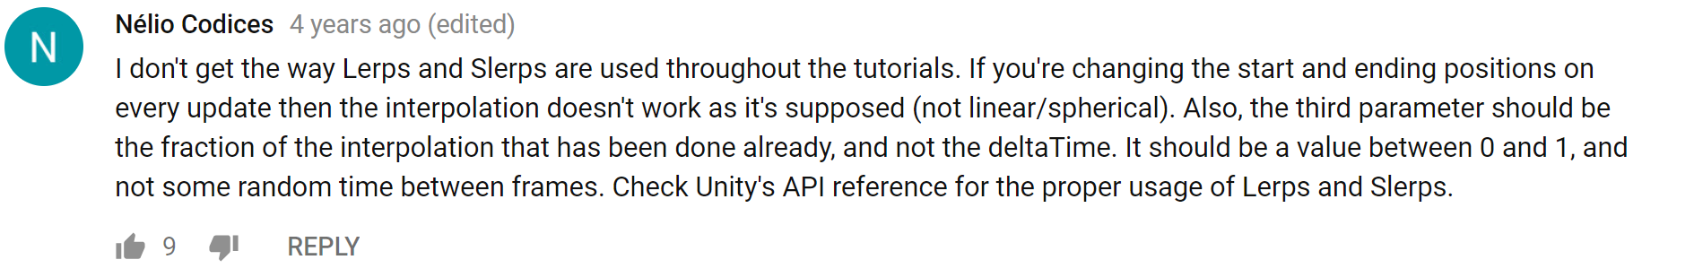
You’re Right Nelio….It’s Not Really Correct….

Slide 4
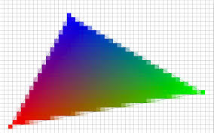
Rendering: Rasterization
We project the 3D geometry to 2D
Compute which pixels are covered
Compute colors for the pixels
Can shade the triangle vertices
Fill interior of the projected polygons
Blend the vertex colors: interpolation
OR shade the pixels directly

Slide 5
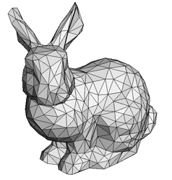


Rasterization: 3D Graphics Pipeline
Vertex Processing
Rasterization
Fragment Processing
Fragments Are like pixels…but they aren’t necessarily the finalized pixels you see in an image.
Each fragment has a 2D location in a raster and a color. Final pixel value is typically found by applying hidden surface removal and possibly compositing to a set of fragments.

Slide 6
Interpolating Colors: Barycentric Coordinates
Describe location of point in a triangle in relation to the vertices
p=(λ₁,λ₂ ,λ₃) where the following are true
p=λ₁a + λ₂ b +λ₃c
λ₁+λ₂ +λ₃= 1
To interpolate a color f(v) sampled at the vertices we just do:
f(p)=λ₁f(a) + λ₂ f(b) +λ₃f(c)
a
p
b
c

Slide 7
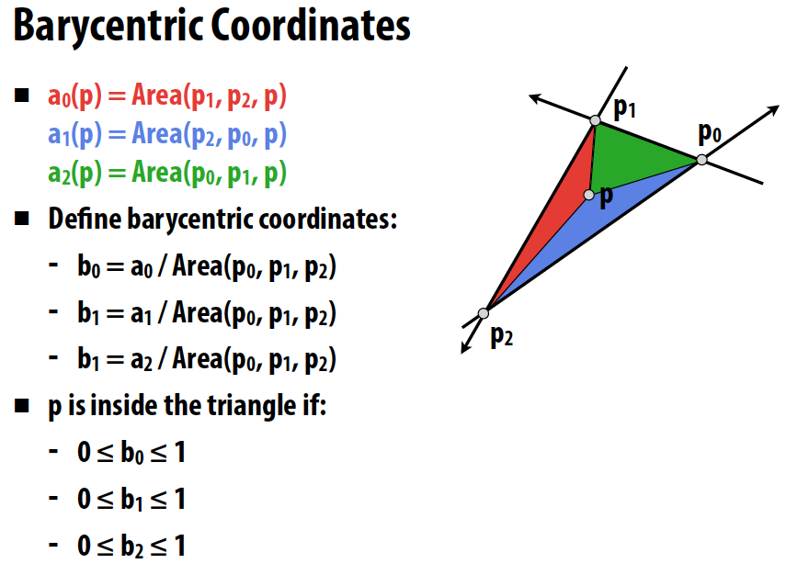
Barycentric Coordinates
should be b2 →
Image from Stanford’s CS348b: Image Synthesis by Matt Pharr
Barycentric coordinates express the location of a point p as a linear combination of the coordinates of 3 vertices
P = (b0,b1,b2)
Notes:
Can you implement a ray-triangle intersection test?

Slide 8

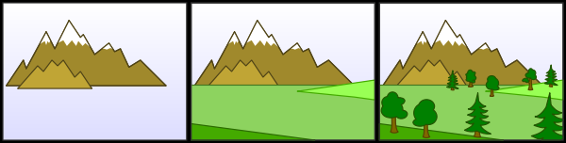
Hidden Surface Removal
We need for objects occluded by other objects to not be seen
Painters Algorithm
Oldest method proposed for doing hidden surface removal
Sort triangles by depth
Draw the triangles into the frame buffer in sorted order
Farthest to closest
…so closer objects are drawn over farther objects
What are some problems with this?

Slide 9
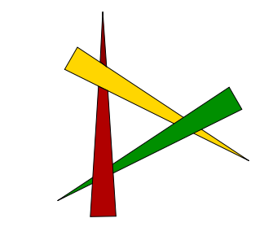
Painter’s Algorithm
It’s expensive to sort….
Also, a single triangle can have multiple depths
Occlusion cycles cannot be resolved

Slide 10
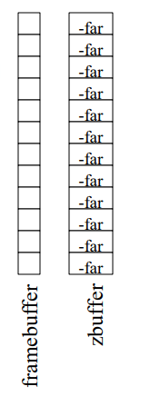
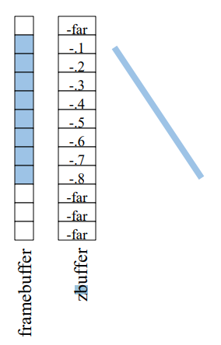
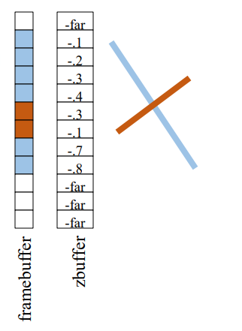
Hidden Surface Removal: Z-Buffer
In addition to the frame-buffer that stores pixel colors
Keep a Z-Buffer that stores pixel depth
For each fragment (x,y) we process check if it is closer than frame-buffer pixel
If so, update frame-buffer and Z-Buffer values

Slide 11
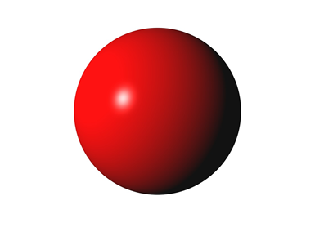

Shading
Shading refers to the process of determining the color for a pixel (or vertex…or polygon) during the rendering process
If we draw sphere using the same red for each pixel…we get something that is not realistic
We need to model how light is reflected from the surface in the real world….
The most common model is the Phong Repflection model
Created 40 years ago…still widely used
Though more physically correct reflection models are starting to be used more

Slide 12
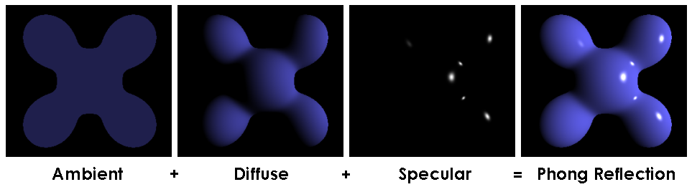
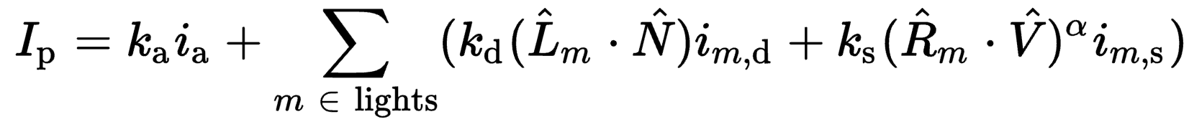
Phong Reflectance Model

Slide 13
Shading
Well…there’s a lot of symbols but the ideas and math are simple
We will create a simple mathematical model for shading
It will be function that takes in:
Light sources
Material properties
Location of viewer
Surface orientation
And returns a color….

Slide 14
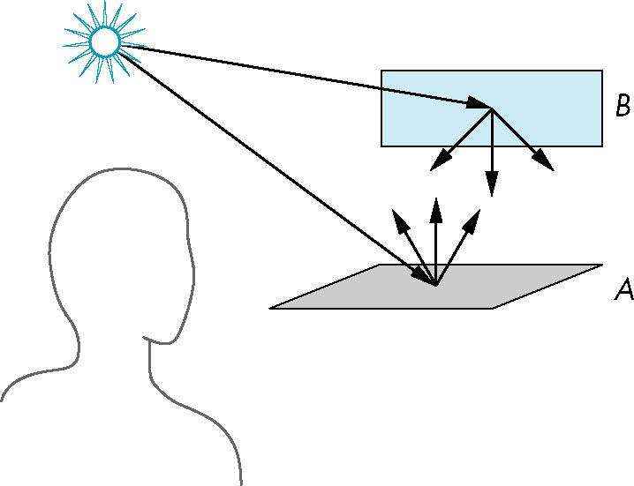
Scattering
Light strikes A
Some scattered
Some absorbed
Some of scattered light strikes B
Some scattered
Some absorbed
Some of this scattered light strikes A and so on

Slide 15
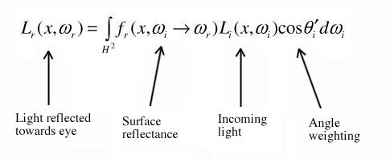
Rendering Equation
Scattering and absorption of light described by the rendering equation
Scattering and absorption are infinite phenomena
Cannot be solved in general analytically
Describes global lighting effects
CS 419 discusses solutions to the rendering equation
Ray-tracing, path tracing, etc.

Slide 16
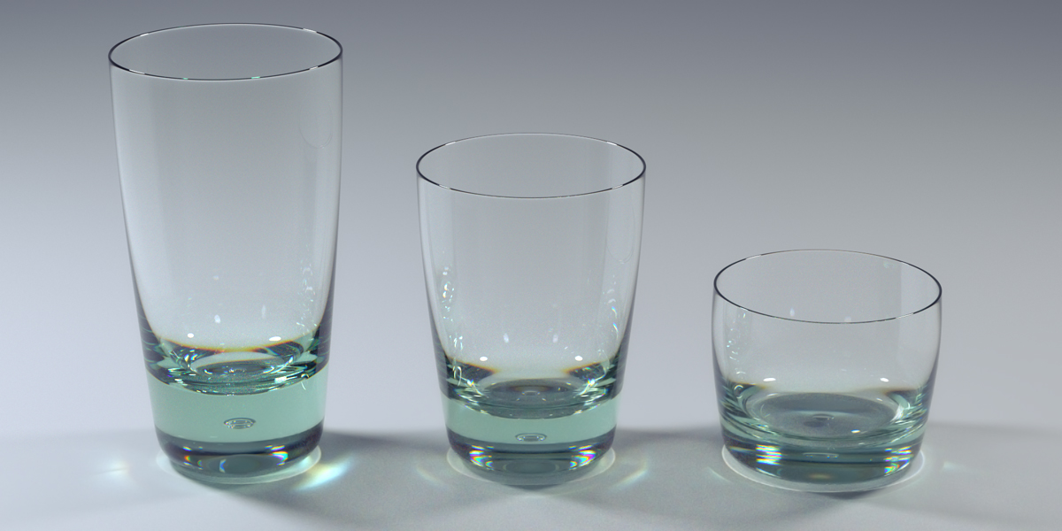
Global Effects

Slide 17
Local vs Global Illumination
Correct shading requires a global calculation involving all objects and light sources
Incompatible with pipeline model which shades each polygon independently
Why do we want to shade each polygon independently?
However, in computer graphics, we are happy if things “look right”
There exist many techniques for approximating global effects
Can anyone guess what you can do to approximate global illumination in rasterization?
How do people render shadows? Or mirrors?

Slide 18
Light-Material Interaction
Light that strikes an object is
partially absorbed and
partially scattered (reflected)
The amount reflected determines
color of the object
brightness of the object
A surface appears red under white light because the red component of the light is reflected
How the reflected light is scattered depends on
the smoothness and orientation of the surface

Slide 19
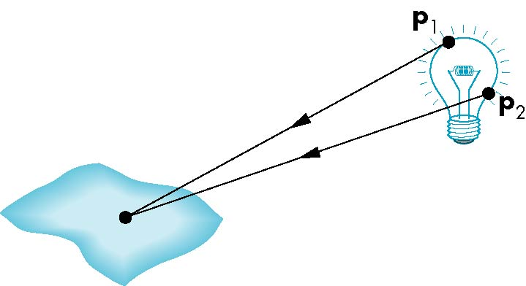
Light Sources
General light sources are complex to model
Would need to integrate light coming from all points on the source

Slide 20
Simple Light Source Models
Point source
Model with position and color
Directional source
Distant source = infinite distance away (parallel)
Ambient light
Same amount of light everywhere in scene
Can model contribution of many sources and reflecting surfaces

Slide 21

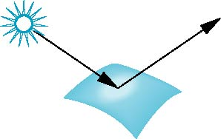
Surface Types
Consider light traveling along a specific ray
The smoother a surface, the more reflected light is concentrated in a single direction
Perfect mirror reflects perfectly in a single direction
A very rough surface scatters light in all directions
smooth surface
rough surface

Slide 22
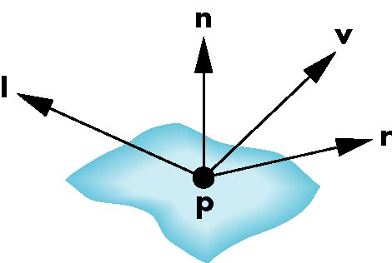
The Phong Reflection Model
A simple model that can be computed rapidly
Has three components
Diffuse
Specular
Ambient
Uses four vectors
To source
To viewer
Normal
Perfect reflector

Slide 23
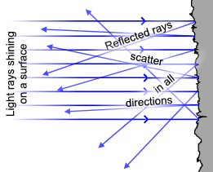

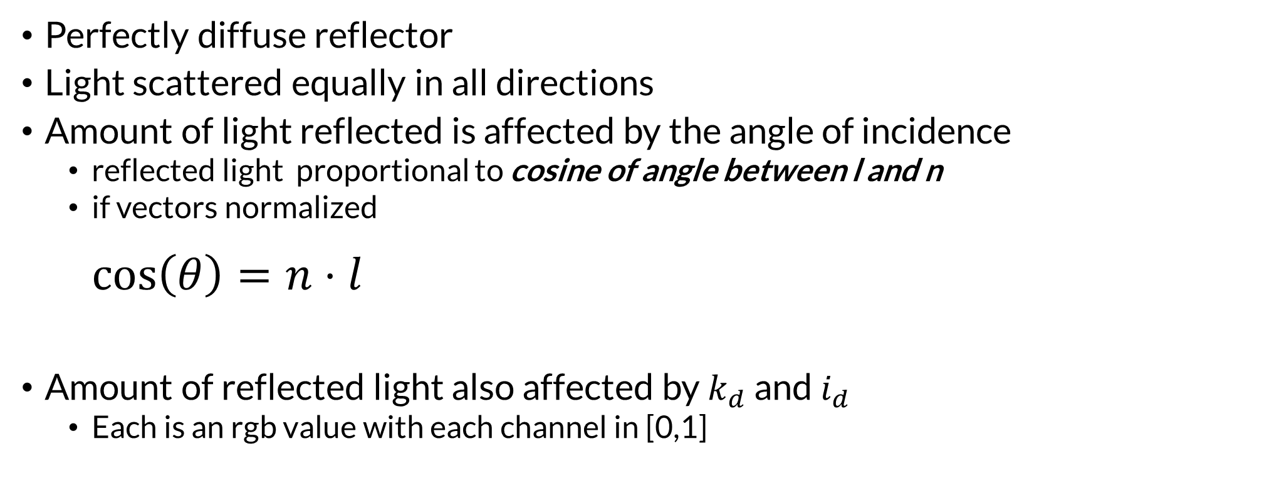
Modeling a Lambertian Surface – Diffuse Reflection
Perfectly diffuse reflector
Light scattered equally in all directions
Amount of light reflected is affected by the angle of incidence
reflected light proportional to cosine of angle between l and n
if vectors normalized $\cos\left(θ\right)=n⋅l$
Amount of reflected light also affected by $k_{d}$ and $i_{d}$
Each is an rgb value with each channel in [0,1]

Slide 24
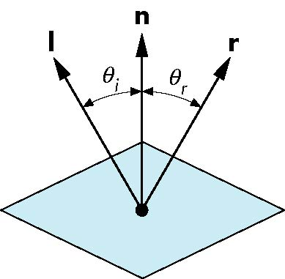

Modeling a Ideal Reflector – Specular Reflection
Incoming light ray is reflected in a single
Normal is determined by local orientation
Given the direction of incoming light…we can find r
l and n are unit vectors
Angle of incidence = angle of reflection
The three vectors will be coplanar
What is another name for an ideal reflector?
r is computed as
$$r=2(l⋅n)n−l$$

Slide 25
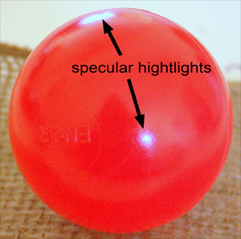
Specular Reflection
Perfect specular reflection
Light is reflected in the single direction r
…the mirror reflection direction
Glossy specular reflection
Scattering clustered around mirror reflection direction

Slide 26
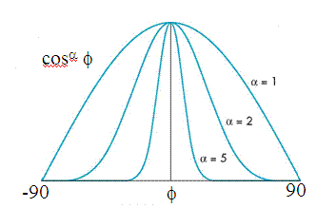
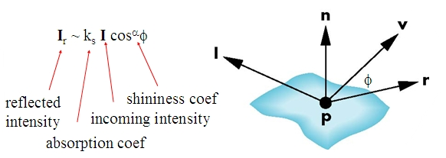
Specular Reflection
Reflectance determined by
Alignment of view vector with mirror reflection vector
Shininess coefficient
High coefficient means smoother look
Maybe 100 for metal…maybe 10 for plastic

Slide 27
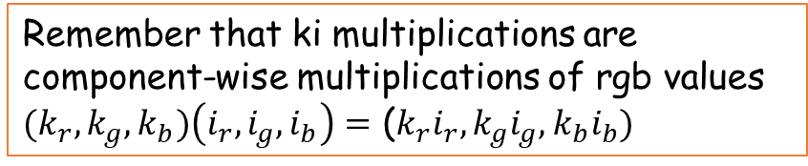
Ambient Light
Result of multiple interactions between light sources and surfaces
Amount and color depend on the color of the light(s) and the material properties
Add k_{a} I_{a} to diffuse and specular terms
Remember that ki multiplications are component-wise multiplications of rgb values
${(k}_{r},k_{g},k_{b})\left(i_{r},i_{g},i_{b}\right)=$ (${k_{r}i}_{r},k_{g}i_{g},k_{b}i_{b})$

Slide 28
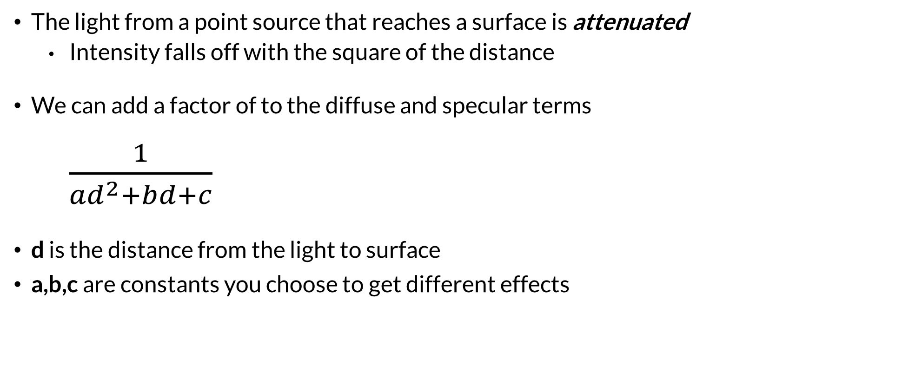
Distance Terms
The light from a point source that reaches a surface is attenuated
Intensity falls off with the square of the distance
We can add a factor of to the diffuse and specular terms $\frac{1}{{ad}^{2}+bd+c}$
d is the distance from the light to surface
a,b,c are constants you choose to get different effects

Slide 29
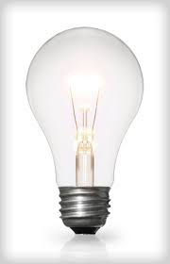
Light Sources
In the Phong Model, we add the results from each light source
Each light source has separate terms for
diffuse
specular
ambient terms
This form does not have a physical justification
Separate red, green and blue components
Hence, 9 coefficients for each point source
I_{dr}, I_{dg}, I_{db}, I_{sr}, I_{sg}, I_{sb}, I_{ar}, I_{ag}, I_{ab}

Slide 30
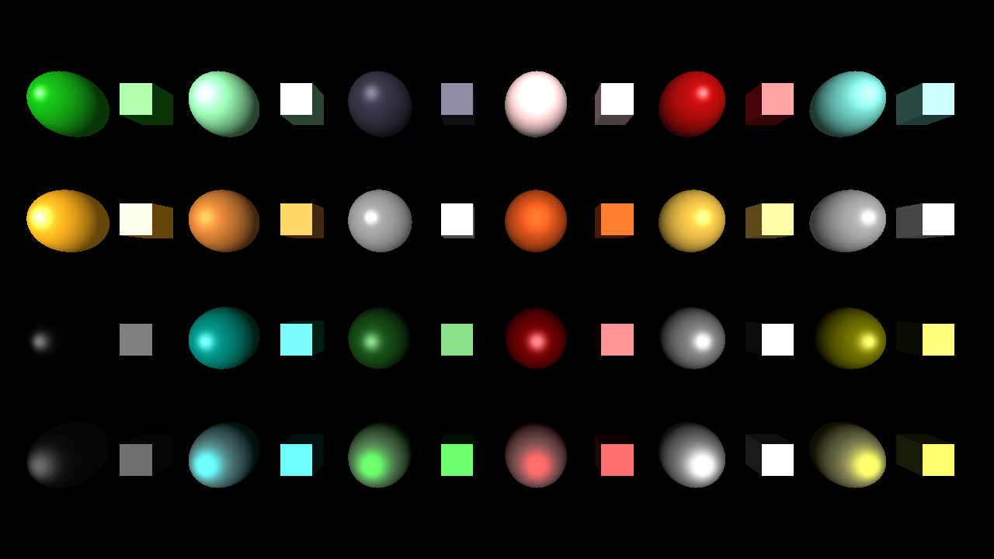

Material Properties
Material properties match light source properties
Nine reflection coefficients
k_{dr}, k_{dg}, k_{db}, k_{sr}, k_{sg}, k_{sb}, k_{ar}, k_{ag}, k_{ab}
These vary from 0 to 1
Materials also have shininess coefficient $α$

Slide 31
Phong Reflectance Model
Summing over all the light sources, the Phong model can be written as

Slide 32
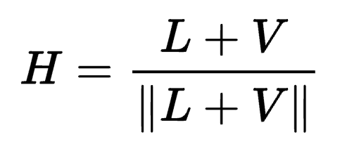
Blinn-Phong Reflectance Model
Jim Blinn suggested an approximating changing specular term
Replace (V · R )ª by (N · H )^{b} where
“Halfway vector”
More efficient in terms of the operations used
Closer to physically correct lighting
Pick exponent b to match what you want
Using higher b>a will make output similar to Phong with a

Slide 33

The Halfway Vector
H is normalized vector halfway between L and V
$$r=2(l⋅n)n−l$$

Slide 34
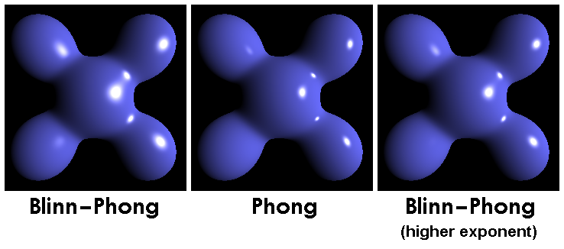
Phong versus Blinn-Phong

Slide 35
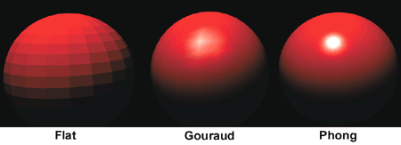
Gouraud and Phong Shading
Gouraud Shading
Find average normal at each vertex
Apply Blinn-Phong model at each vertex
Interpolate vertex shades across each polygon
Phong shading
Find average normal at each vertex
Interpolate vertex normals across edges
Interpolate edge normals across polygon
Apply Blinn-Phong model at each fragment

Slide 36
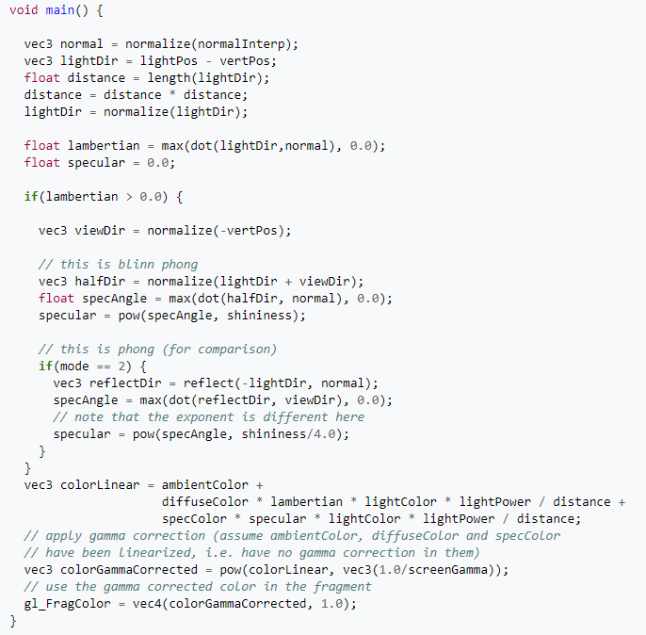
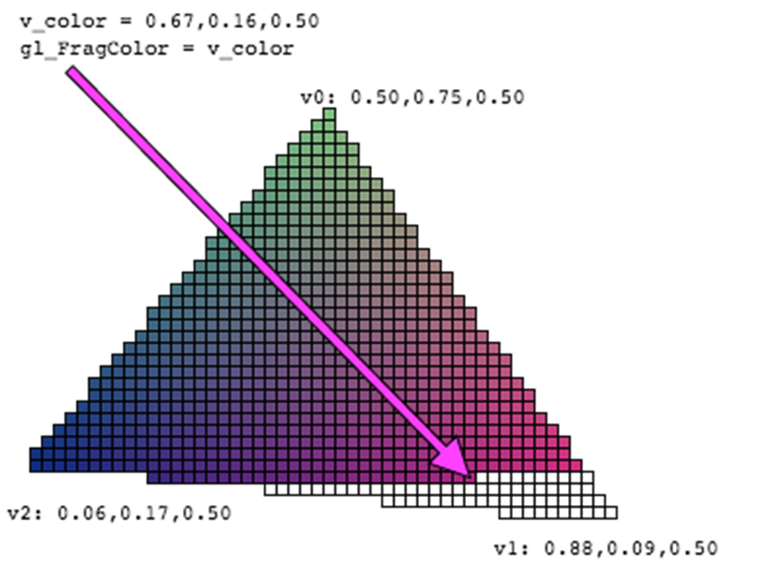
Shaders
In modern rendering systems, colors are computed by shader programs
These shader programs run on the GPU

Slide 37
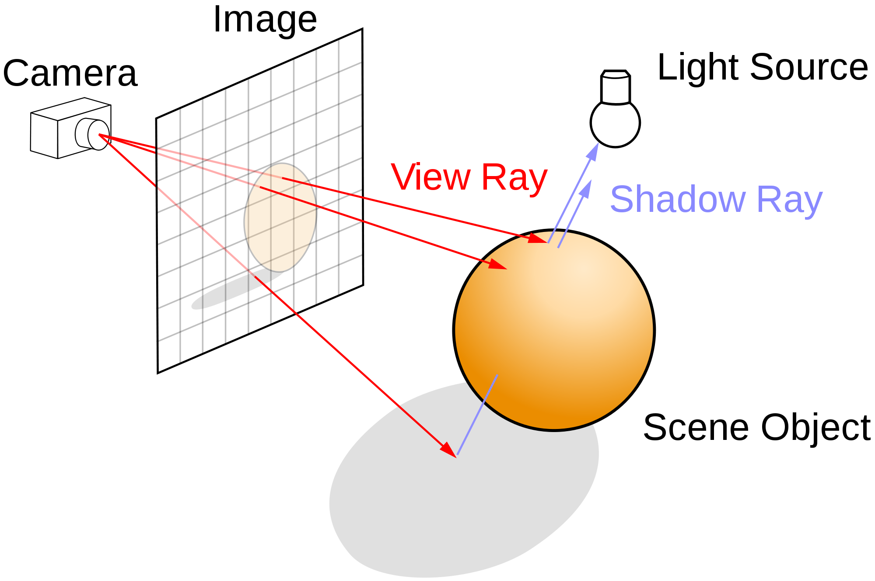
Ray Tracing
Follow ray of light….
Can trace from an eyepoint through a pixel
See what object the ray hits…
Compute the color of the light being reflected from the hit point.

Slide 38
Ray Tracing: Extremely Flexible
Can simulate global visual effects such as
Mirror-like reflection
Transparency and translucency
Global illumination (indirect lighting and color bleeding)
Soft shadows….
And mores……

Slide 42
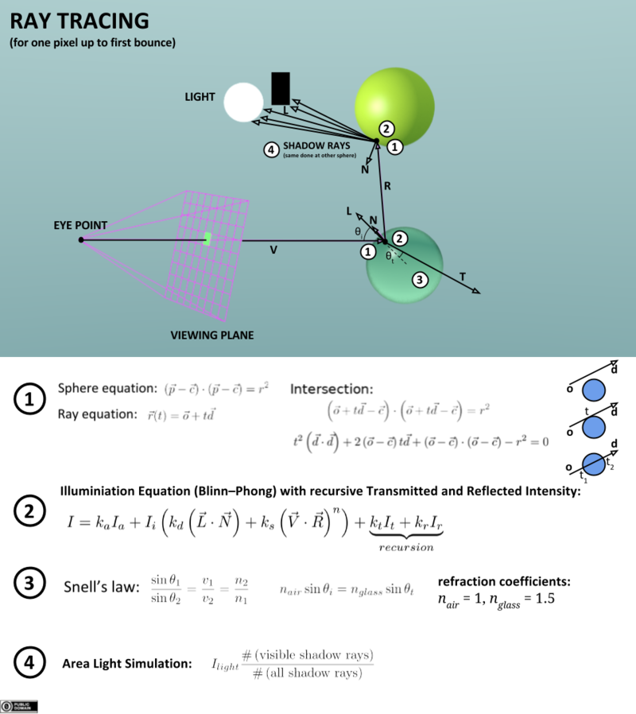
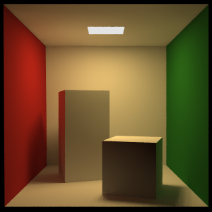
Ray-Tracing: Computationally Intense
LOTS of rays get generated
Each pixel requires multiple primary rays for anti-aliasing
Each hit on a surface recursively generates more rays
Cornell Box About 100,000 rays per pixel

Slide 43
Real-Time Ray-Tracing

Slide 44
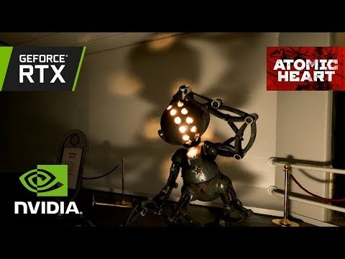
NVIDIA RTX: Real-Time Ray-Tracing Demo

